Slide 1
Time Series Super Powers
Understanding the Fourier Transform, FFT, and Basic Time-series Analysis

Slide 2
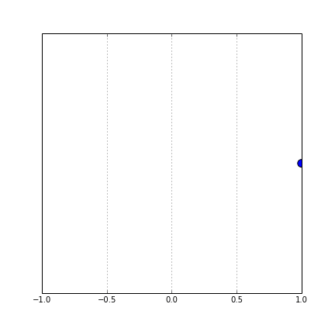
This is the story of a moving point
position = cos(time)
This type of motion, moving to the right, slowing to a stop and then moving to the left - has a name. It's called "sinusoidal" motion.

Slide 3
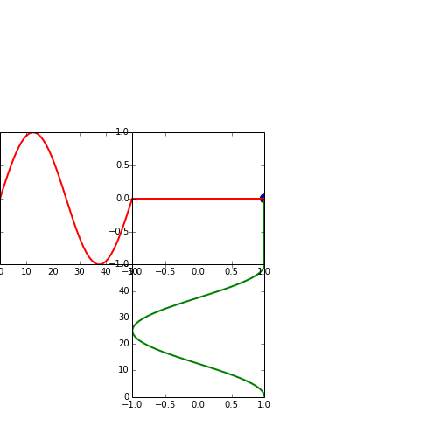
Then it moved in 2 dimensions
Vertical Position = sin(time)
Vertical Dimension
“Imaginary”
Horizontal Dimension
“real”
This point’s motion in both dimensions was independent of each other. For various reasons we call the two dimensions this point moves in the real and the imaginary axis. In fact though, there's nothing truly imaginary about it.
Horizontal Position = cos(time)

Slide 4
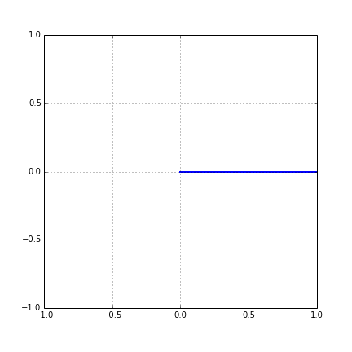
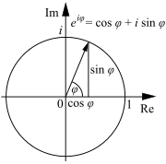
Sine + Cosine is A Circle
Horizontal Dimension = sin(time)
Vertical Dimension = cos(time)
Notes:
Point rotating around a circle.

Slide 5
A Point Rotating Around A Circle
1 revolution is a circumference
1 circumference is 2π radiuses
In 1 second the point travels 2π radius.
Notes:
Speed is frequency. The number of revolutions per second.

Slide 6
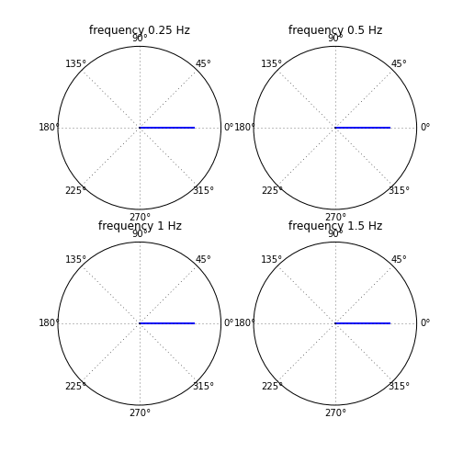
Points Rotate At Different Speeds
Think of hands of a clock. The hands move at different speeds/frequencies.
Hour hand - 2π radius/3600 seconds
Minute hand - 2π radius/60 seconds
Second hand - 2π radius/1 second
2π2.77e-4 Hz
2π1.66e-2 Hz
2π1 Hz
Notes:
Circles rotating at different speeds.

Slide 7
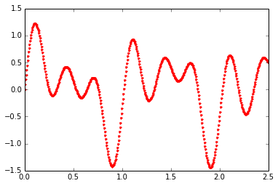
Time Series of Measured Data
Digital data is discrete and measured at a fixed interval.
Time time axis is really samples.
Samples are collected every T_{s} seconds, or a frequency of F_{s} = 1/T_{s}
Notes:
Examples of measured data?

Slide 8
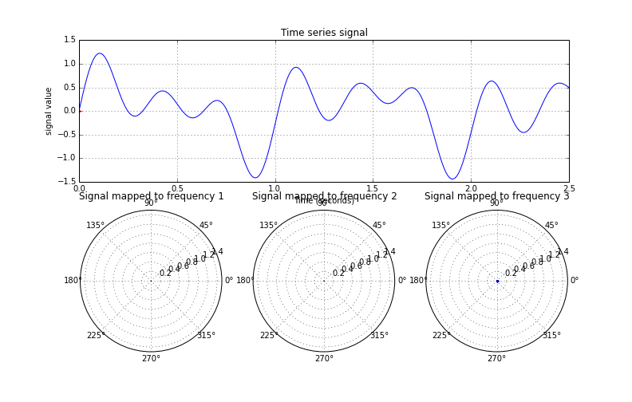
Projecting Onto the Circle
Notes:
The value of the measured data controls the LENGTH of the “arm” of the clock face. The frequency determines the angle in 2 dimensions.

Slide 9
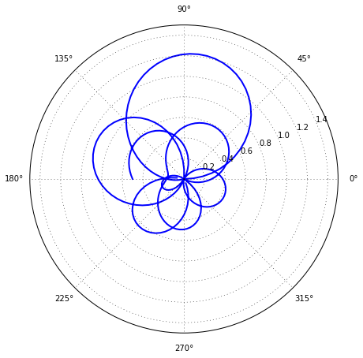
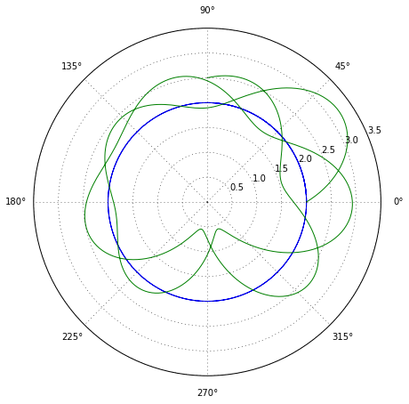
What if we Wrapped Our Signal Around a Circle?
1 dimensional data becomes 2 dimensional data!
Notes:
The green “line” represents many individual points mapped around the circle. There are hundreds of points.
The “time” dimension has been trasferred to a “spatial” dimension – time determines how far around the circle the points map.

Slide 10
What Happened to Time?
Time is been transferred to the position of the “clock hand” around the circle.
3T_{s}
2T_{s}
Time passes – T_{s}
Distance passes – speed x time
Distance:
(2πf Ts) radius/seconds x seconds

Slide 11
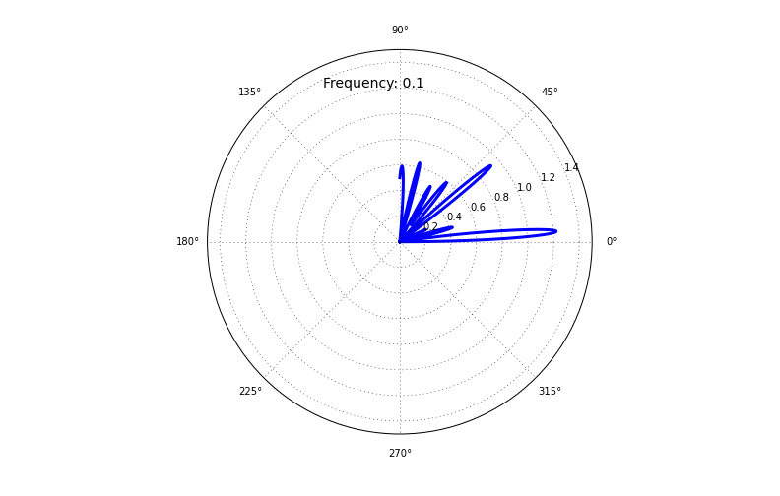
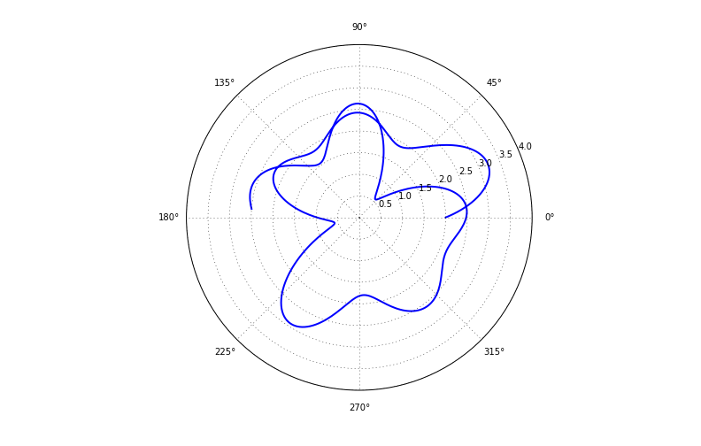
Mapping the Signal on Different Frequency Circles
As frequency of the circle goes up, the signal gets stretched further around the circle. At each time step (Ts) of the measured signal the “clock hand” travels around the circle.
Notes:
ANIMATE THIS!

Slide 12
So Now we Have a Bunch of Measurements in 2 Dimensions …
Each measured point now lives in 2 dimensions.
We call this a “vector”.
We can add vectors together.
Let’s SUM ALL THE POINTS.

Slide 13
Adding 2Dimensional Lines
These are called “vectors” – add dimensions independently.
A+B = C
B
B
A
A
Points on opposite sides add destructively – get smaller.
Points “near” each other add together to be bigger.

Slide 14
Vectors have Lengths and Angles
A point in 2 dimensions can be expressed by it’s horizontal and vertical location OR
Described by it’s length and angle.
Point
Length
Angle

Slide 16
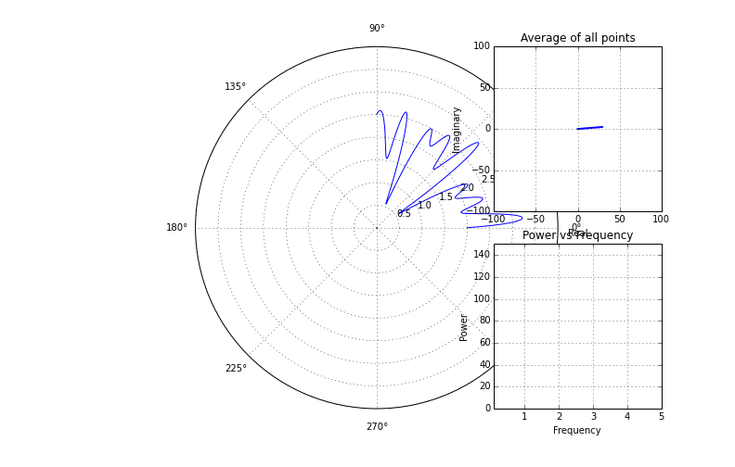
Average the 2D Signal
Average all the 2D points
Find the length of the average vector

Slide 17
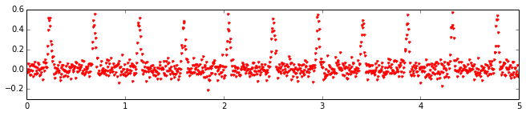
How about a different Signal?

Slide 18
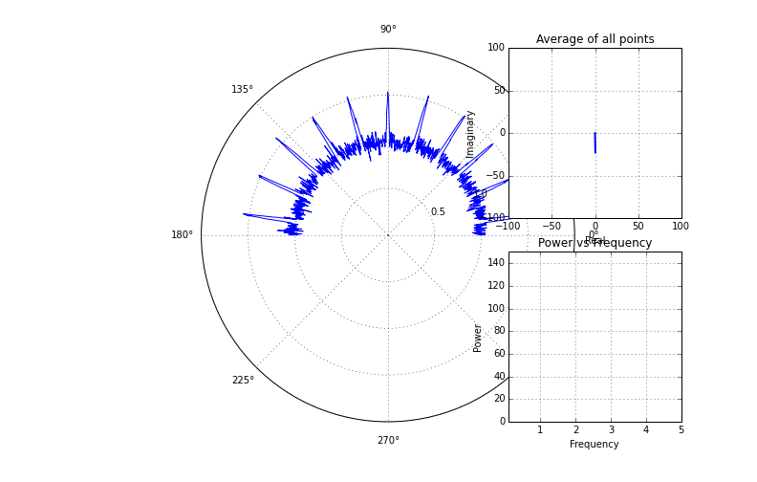
How about a Different Signal?

Slide 19
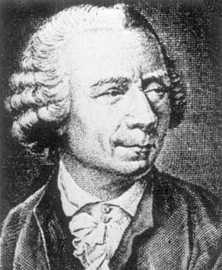
Leonard Euler
e^{jx} is shorthand notation for a circle!
We can write the sum of a cosine and and sine in two dimensions in a compact form:
exp(jx) = sin(x) + j*cos(x)
Notes:
Attribution: http://www-history.mcs.st-andrews.ac.uk/Biographies/Euler.html

Slide 20
Mathematically This Is
X[f_{k}] = SUM_{i}(x[i] * exp[-j2πf_{k}* {i/N} ] )
exp(-j2πf₁)
x[i]
exp(-j2πf₂)
exp(-j2πf₃)
i: 0 1 2 3 … N-1
i/N – the percentage of distance around the circle for each sample.
X[f_{k}] is complex
Notes:
Discrete Fourier Transform!

Slide 21
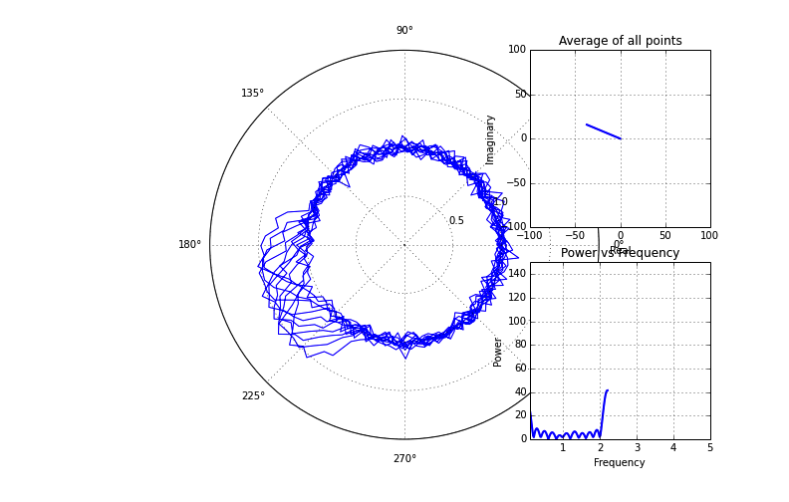
Real{X[f_{k}]} = SUM_{i}(x[i] * cos(2πf_{k *} {i/N}))
These equations describe the average of all the points wrapped around the circle – one vector.
OR
Im{X[f_{k}]} = - SUM_{i}(x[i] * sin(2πf_{k *} {i/N}))

Slide 22
The Process
FFT
Measure Data
Pick Frequency K
Arrange Measured Points around Circle of Frequency K
Average All Points
Compute Length and Angle of Average Vector
Plot Power vs. Frequency

Slide 23
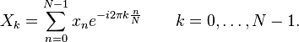
Take Note
The sample rate (T_{s}) doesn’t explicitly appear in the equation. It’s independent of the math and is used for interpretation.
There’s no point in measuring frequencies greater than (Sampling Frequency)/2.
Each frequency f_{k} is computed by taking the sum of ALL MEASURED POINTS.

Slide 24
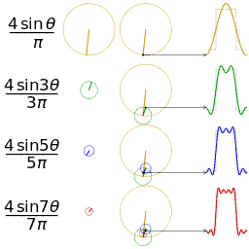
A View in Reverse
You can also think of a measured signal as being approximated by the sum of many rotating circles:
Notes:
http://en.wikipedia.org/wiki/Fourier_series

Slide 25
Pseudocode!
ft = []
for frequency in frequencies:
average_point = 0. + 1*j*0.
for n,meas in zip(range(1,N_measurements),measurements):
fractional_distance = float(n)/N_measurements
average_point += \ meas*np.exp(-1j*2*pi*frequency*fractional_distance)
average_point = average_point / N_measurements
ft.append(average_point)
ft is a vector of complex numbers – the real and imaginary location of each point. The length is abs(ft)

Slide 26

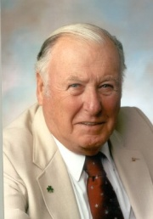
Fast Fourier Transform (FFT)
J. Tukey
J. Cooley
The naive discrete Fourier transform is O(N²)
Cooley-Tukey reduced to O(n log n) – the Fast Fourier Transform (FFT).

Slide 27
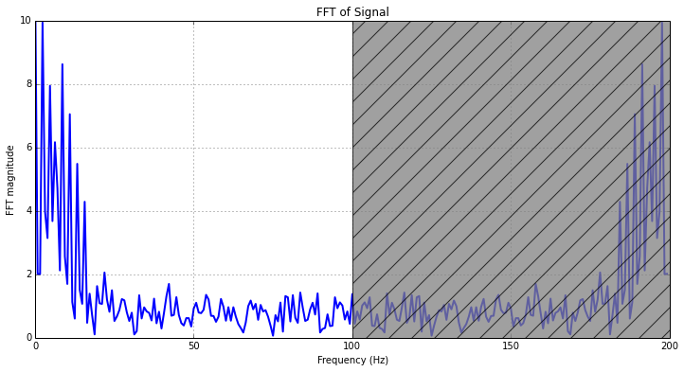
What Does the FFT Return?
x[n]
FFT(x,N):
X – time series
N – number of bins to calculate
FFT[k]
k is from 0 to N
You only care about FFT[0] to FFT[N/2]. Usually you only care about the absolute value of the complex (2 dimensional) output.
The transform is symmetric around Fs/2:
e.g. If you sample at 100 Hz, the FFT(10Hz) will look like FFT(190 Hz).
The function returns the FFT evaluated from 0 Hz all the way up to Fs Hz – half of this is redundant*.
*If your measured signal is complex, this isn’t true. This is rarely the case.

Slide 28
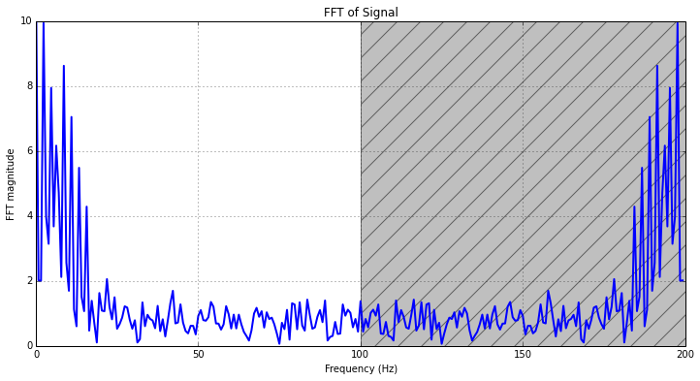
What Frequencies Does the Output Correspond to?
sig
N_fft = 256.0
Fs = 200
freqsig = fft.fft(sig,n=N_fft)
abs(freqsig)
freq_axis = np.arange(0,Fs,Fs/N_fft)

Slide 29
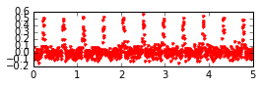
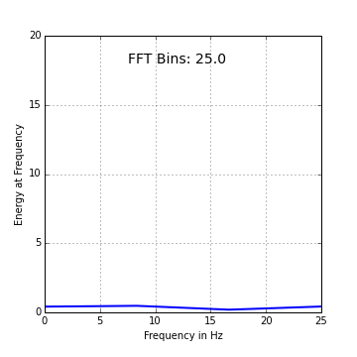
How Many Bins?
Each array element of the FFT corresponds to a frequency bin. Each bin is F_{s}/N_FFT wide.
The more measurements you have, the better precision you get (limited by floor(log2(N_samples))
FFT

Slide 30
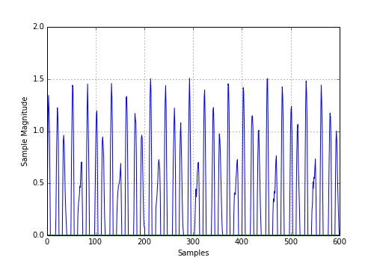
Practical Note: Windowing Functions
Taper the signal at beginning to improve fidelity: Hamming, Hanning, Blackman, etc.

Slide 31
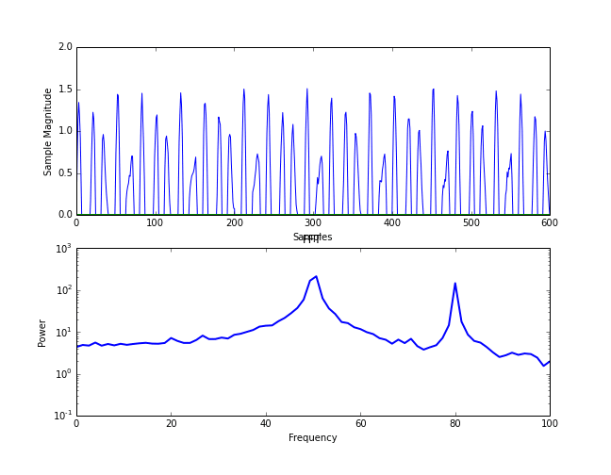

Slide 33
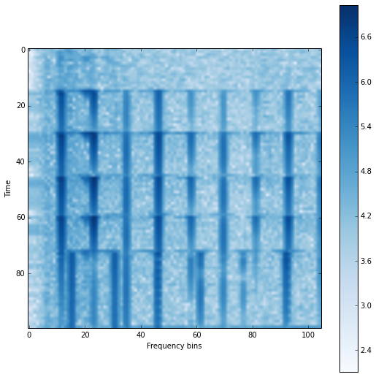
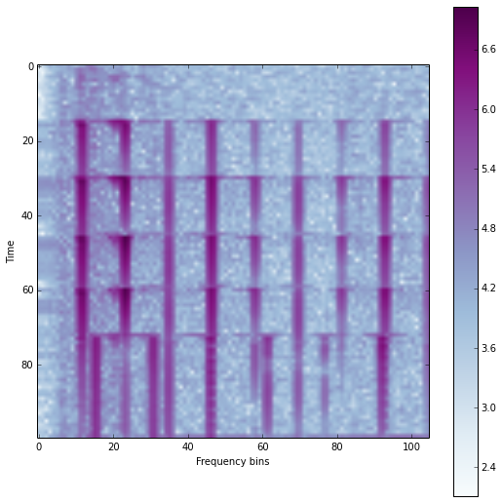

Slide 34
Final Notes
Many frequency plots have the Y-axis in logarithmic scale – each tick is 10x larger than the next.

Slide 35
Helpful Resources
http://www.dspguide.com/ch8/6.htm

